Slide 1
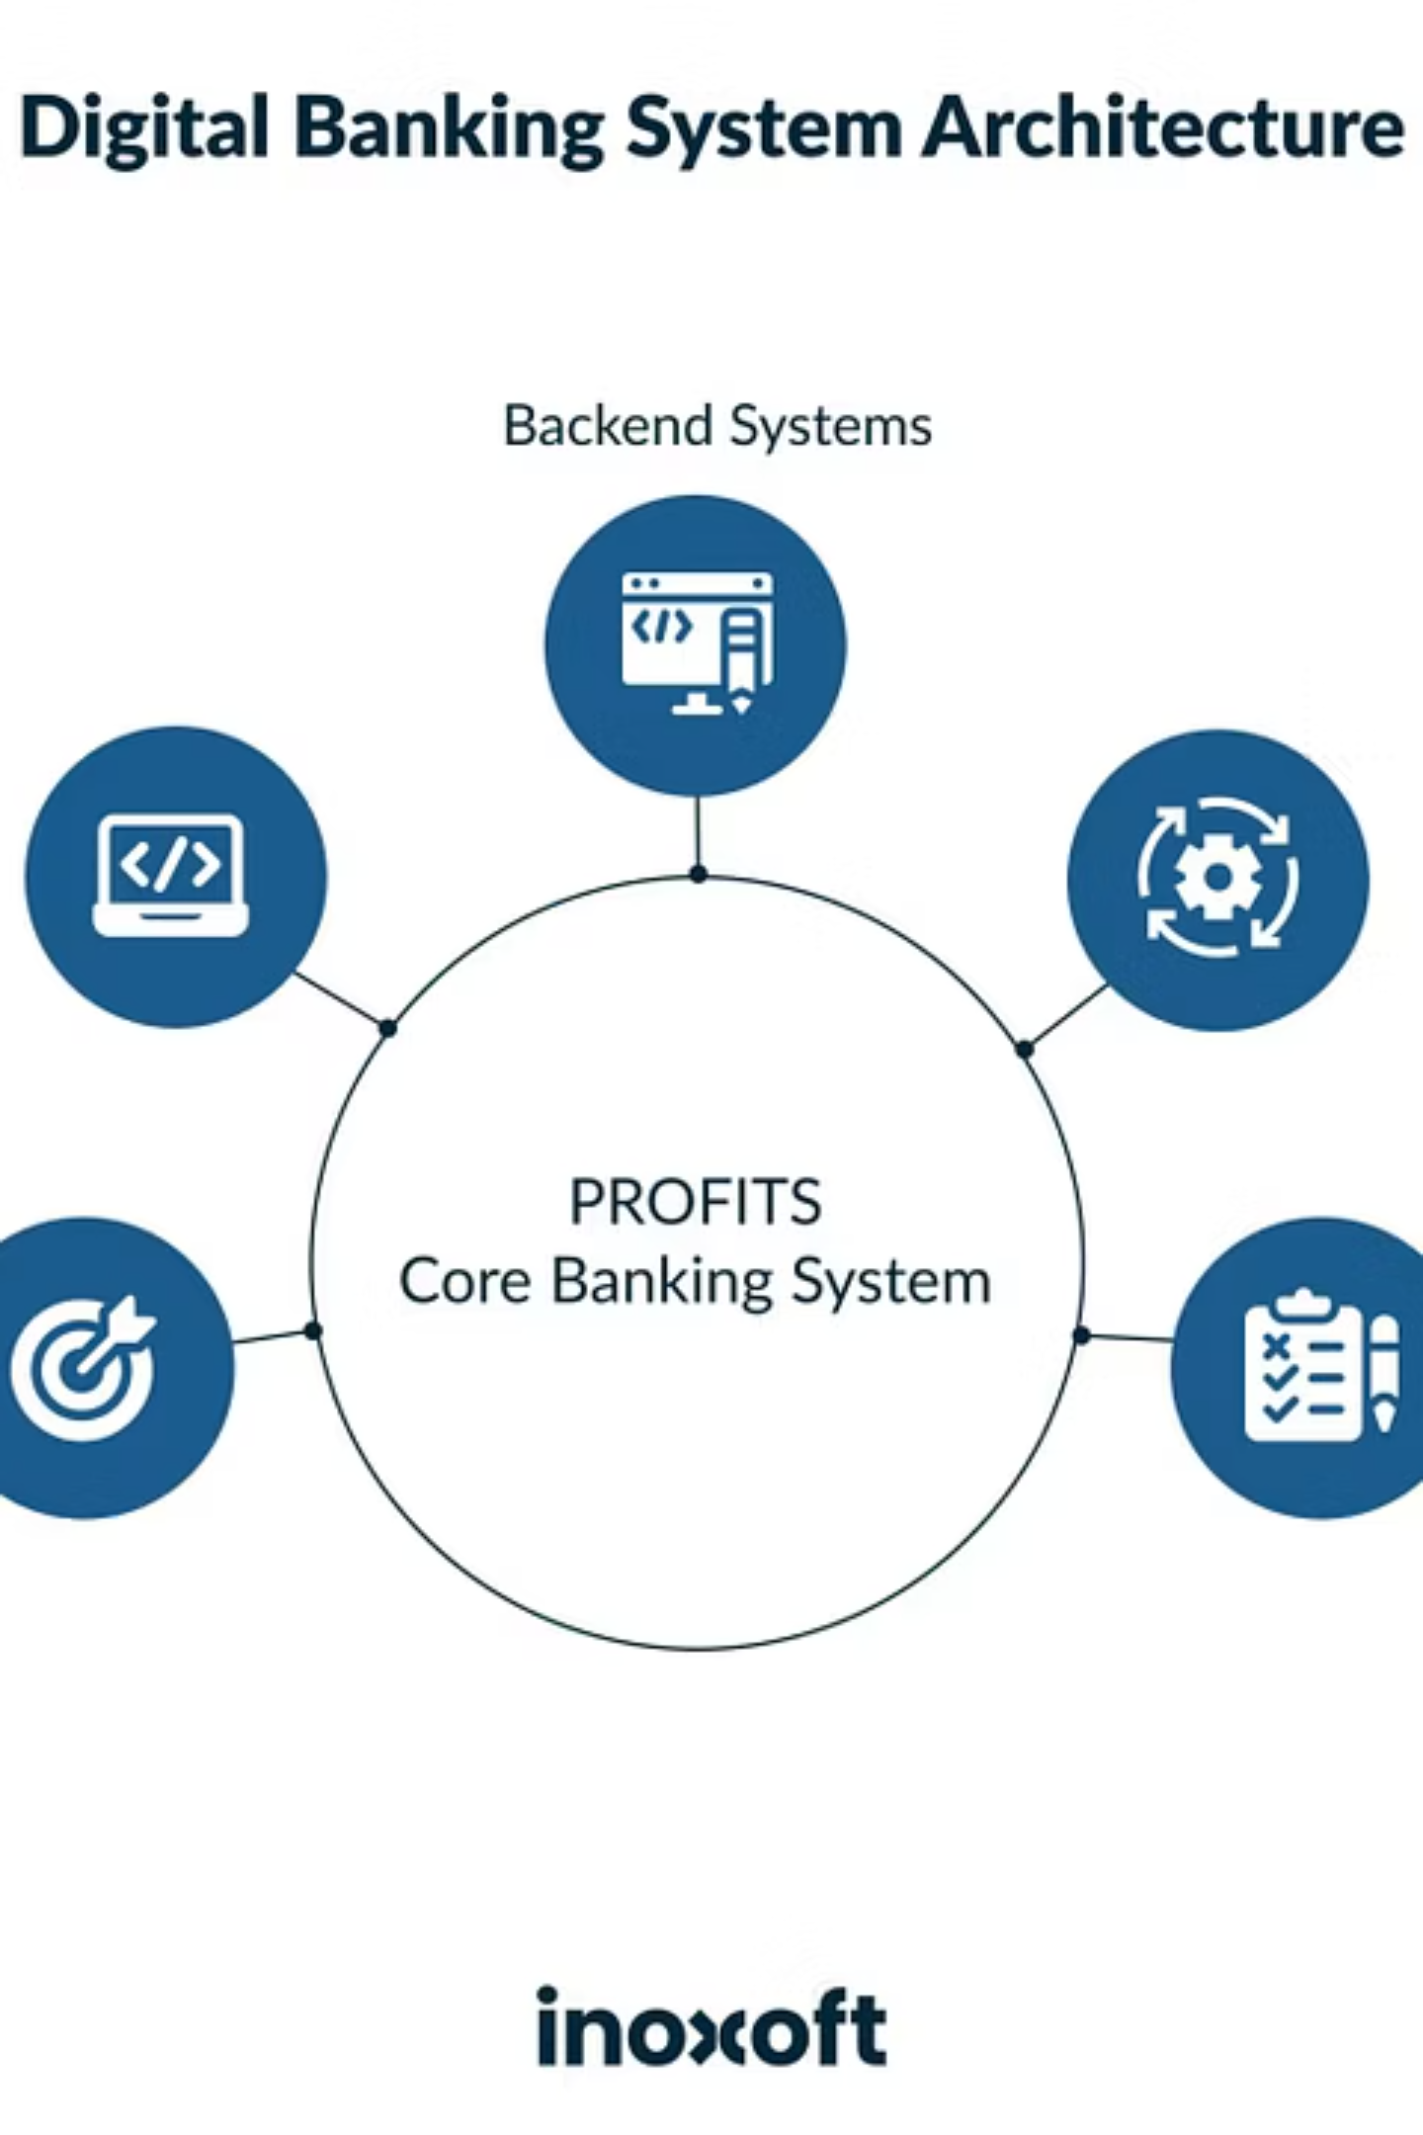
Banking Activity Simulation Platform
A comprehensive full-stack banking system developed during Infosys Springboard Virtual Internship

Slide 2





STUDENT PROJECT
JAN 28, 2026
Banking Activity Simulation Platform
Java Full Stack
Infosys Springboard
Student Team
Backend & frontend integration
Virtual internship program
Developed by interns

Slide 3

Project Overview
This platform was developed during our internship to simulate real-world banking operations. It bridges the gap between theoretical knowledge and practical application, providing hands-on experience with enterprise-level banking systems.
01
Learn Banking Operations
Understand how real banking systems function
02
Backend Integration
Connect business logic with databases
03
Frontend Development
Create intuitive user interfaces
04
Complete System
Build end-to-end banking solution

Slide 4
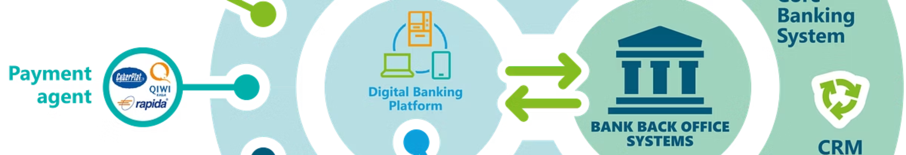
Problem Statement
Complexity of Banking Systems
Theory vs. Practice Gap
Technical Challenges
Students struggle to grasp backend architecture, database operations, and API development without hands-on experience
Banking platforms handle numerous operations daily including transactions, account management, and security protocols
Learning banking concepts through textbooks alone doesn't provide the practical understanding needed in real-world scenarios
Our solution: A fully functional simulation platform that allows students to learn by building and testing real banking operations in a safe environment.

Slide 5

Our Solution
Complete Banking Simulation
We created a comprehensive application that replicates core banking functionalities, enabling users to perform essential operations while learning system architecture.
Account Management
Users can create and manage multiple bank accounts with unique identifiers
Transaction Processing
Full support for deposits, withdrawals, and inter-account transfers
Activity Tracking
All transactions are logged and stored for comprehensive reporting
Smart Alerts
Automated notifications sent when account balance falls below threshold

Slide 6





Key Features
Create Account
Deposit Money
Register new bank accounts with customer details and initial deposit amounts
Add funds to accounts with instant balance updates and transaction recording
Withdraw Money
Transfer Money
Securely withdraw funds with balance verification and fraud prevention checks
Move funds between accounts seamlessly with automatic balance adjustments
View Account Details
View All Accounts
Access comprehensive account information including balance and transaction history
Administrative view of all registered accounts in the system for management

Slide 7





Backend Implementation
Core Java
Business logic and application flow powered by robust Java architecture
OOP Concepts
Classes, inheritance, and polymorphism for clean, maintainable code structure
Exception Handling
Comprehensive error management ensuring system stability and reliability
JDBC Integration
Database connectivity enabling persistent data storage and retrieval
File I/O
Transaction logging to files for audit trails and reporting capabilities

Slide 8

Database, Alerts & APIs
MySQL Database
Email Alerts
Stores all transaction data, account information, and customer details securely
Automated notifications sent when balance drops below minimum threshold
JDBC Operations
REST APIs
Handles CREATE, READ, UPDATE, and DELETE operations with prepared statements
RESTful endpoints created using Spark Java framework for frontend integration
File Reporting
Postman Testing
Maintains transaction history logs for audit purposes and data backup
Comprehensive API testing ensuring reliability and correct response formats

Slide 9
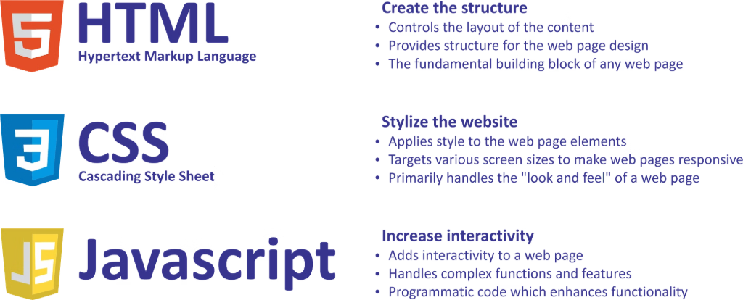
Frontend Implementation
User-Friendly Web Interface
Built with modern web technologies to create an intuitive, responsive banking experience accessible from any browser.
HTML Structure
1
Semantic markup for accessibility and clean document structure
2
CSS Styling
Professional styling with responsive design and smooth animations
JavaScript Logic
3
Dynamic interactions and client-side validation for better UX
4
Fetch API
Asynchronous calls to backend REST APIs for real-time data updates
Result Display
5
Clear presentation of transaction results and account information

Slide 10




Learning Outcomes
100%
100%
100%
Real Banking Workflows
Backend Expertise
API Development
Complete understanding of transaction processing
Mastered Java development and architecture
Created and tested RESTful web services
Database Integration
Full Stack Communication
Problem-Solving Skills
Learned JDBC and SQL operations for data persistence
Enhanced debugging and critical thinking abilities
Connected frontend JavaScript with backend Java APIs
Thank You!
Questions and feedback welcome

